Slide 1
Do Now Page 1
What bonding occurs between metals and non-metals?
What is the chemical formula of methane?
What does DNA stand for?
What is the constant speed equation?
What is the chemical formula for an alkane with 117 carbon atoms?
What is the atomic number of the largest predicted element?
Ionic
CH₄ (C_{n}H_{2n+2})
Deoxyribonucleic Acid
$$Speed, s (m/s)= \frac{Distance, d (m)}{Time, t (s)}$$
C₁₁₇H₂₃₆ (Heptadecahectane)
184 (Uoq - Unoctquadium)

Slide 2


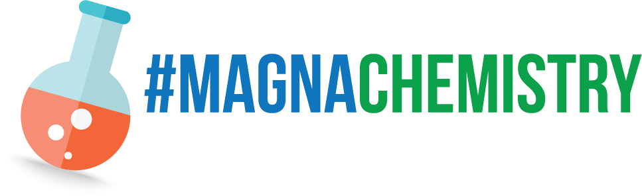

Welcome to Education Extravaganza
2022
Taught By: Neo Skinner and Tyler Rocha
Scientific Advisor: Ephram Matocha

Slide 3
Lesson 1 The Atom and Advanced Analysis Techniques
Physics
Taught By: Neo Skinner
Scientific Advisors: Tyler Rocha and Ephram Matocha

Slide 4
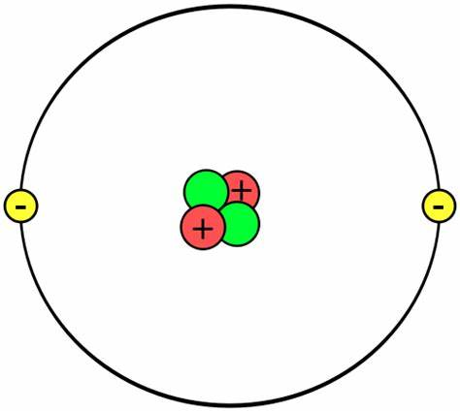
The Atom
Proton
Electron
Nucleus
Neutron
Electron Shell
OR Energy Level

Slide 5
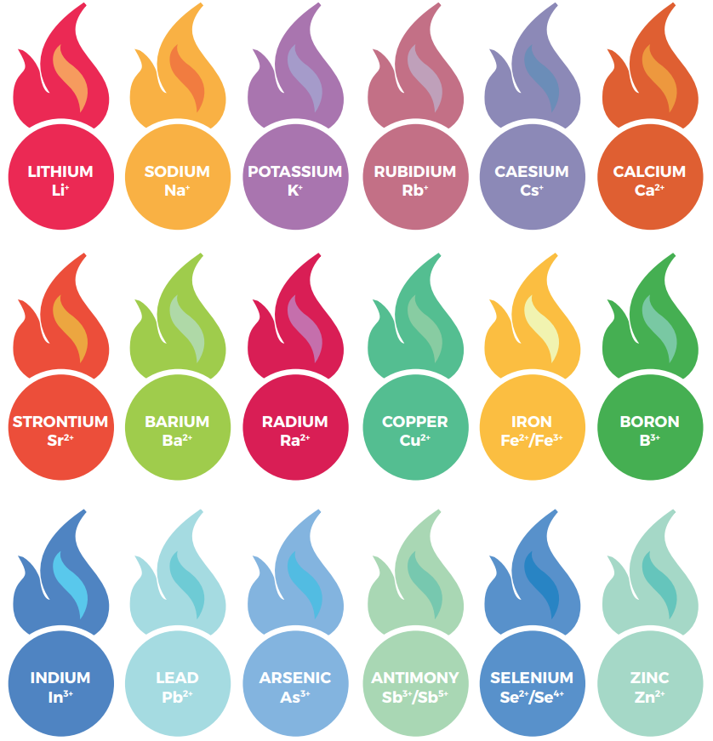
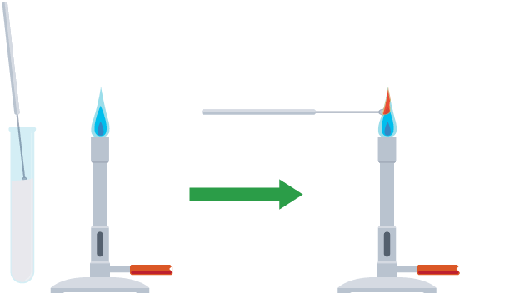
The Flame Test

Slide 6
Progress Check Page 3
Sodium
Green
Lithium
Light Blue
Boron
Light Green
Selenium
Yellow
Barium
Red

Slide 7
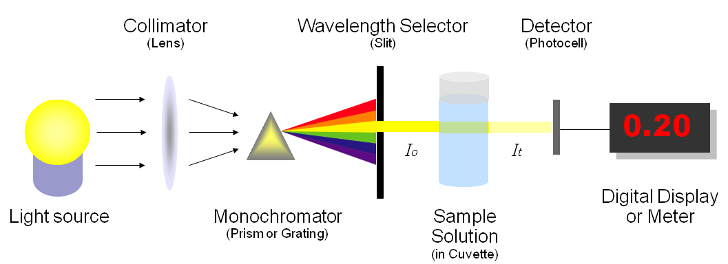
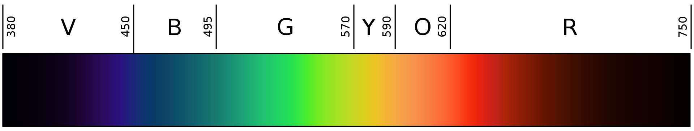
Spectroscopy

Slide 8
Mastery Questions Page 3
1. Prism (1)
2. Red (1)
3. Each point worth 1 mark – maximum of 3:
Colours can be too similar
Not all elements change the colour
Only metal ions can be used
Some compounds are unsafe to test
Qualitative data
4. Each point worth 1 mark – maximum of 5:
Flame Test:
Colours can be too similar
Not all elements change the colour
Only metal ions can be used
Some compounds are unsafe to test
Qualitative data
Spectroscopy:
Produces a spectrum or component colours
Spectrum is unique
Quantitative data

Slide 9
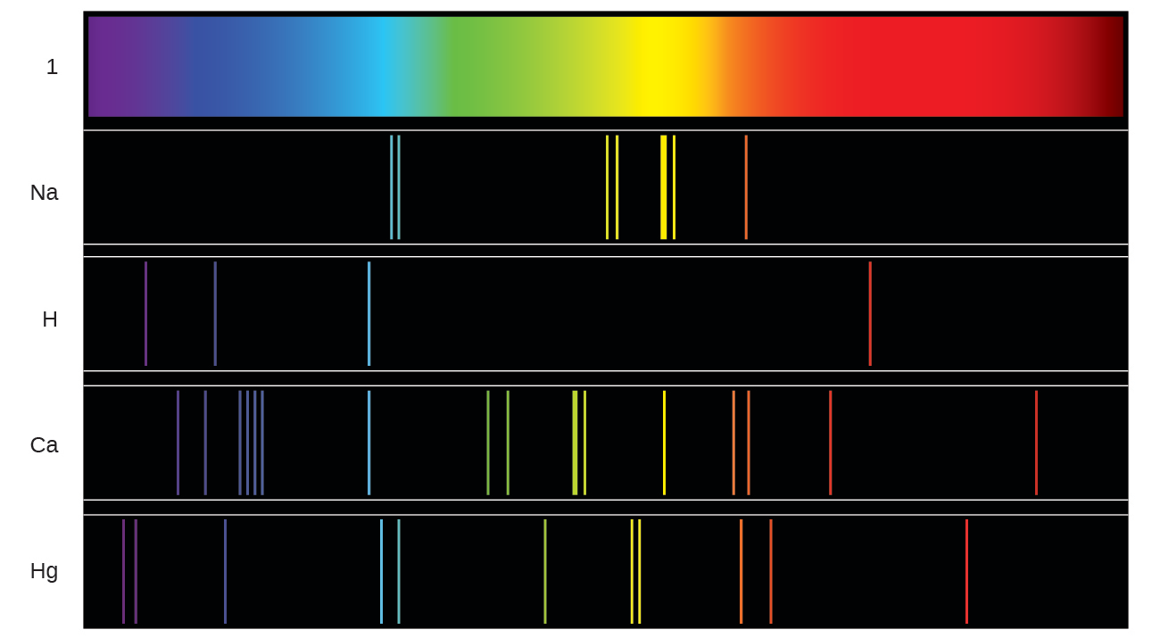
The Emission Spectrum

Slide 10
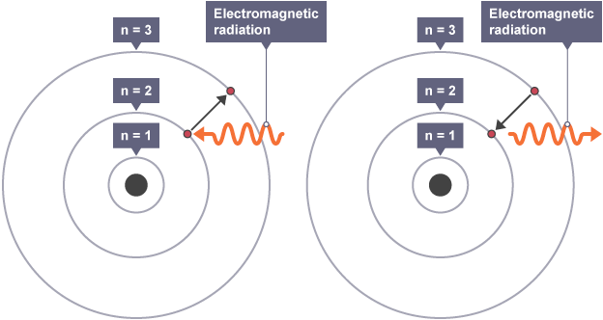
Electron Excitation

Slide 11
Deliberate Practice Page 5

Slide 12
Q1.
(a) decreases
correct order only
1
increases
1
(b) (i) intensity (of transmitted light ) depends on thickness
or to enable a valid comparison or it is a control variable
accept absorption depends on thickness
it would affect the results is insufficient
fair test is insufficient
1
(ii) transmits the least light
or absorbs the most light
accept very little light is transmitted
do not accept transmits none of the light
do not accept absorbs all of the light
any reference to heat negates this mark
1
[4]

Slide 13
Q2.
electron
1
atom
1
nucleus
1
orbit
1
[4]
Q3.
atoms with the same number of protons
allow atoms of the same element
1
but with a different number of neutrons
1
(b) protons = 11
1
neutrons = 12
1
(c) electrons falling to a lower energy level
1
[5]

Slide 14
Do Now Page 9
How many chambers does the heart have?
What is Avogadro’s constant?
What protein naturally seals cuts, creating scabs?
What form of current is distributed through the UK mains power grid?
What is the largest particle accelerator?
What is the category of particle that pions are a part of?
4
6.022×10²³ (6.02214076×10²³)
Fibrinogen
Alternating Current (AC)
The Large Hadron Collider (LHC – CERN)
Hadrons (Mesons)

Slide 15
Lesson 2 The Periodic Table
Chemistry
Taught By: Neo Skinner
Scientific Advisors: Tyler Rocha and Ephram Matocha

Slide 16
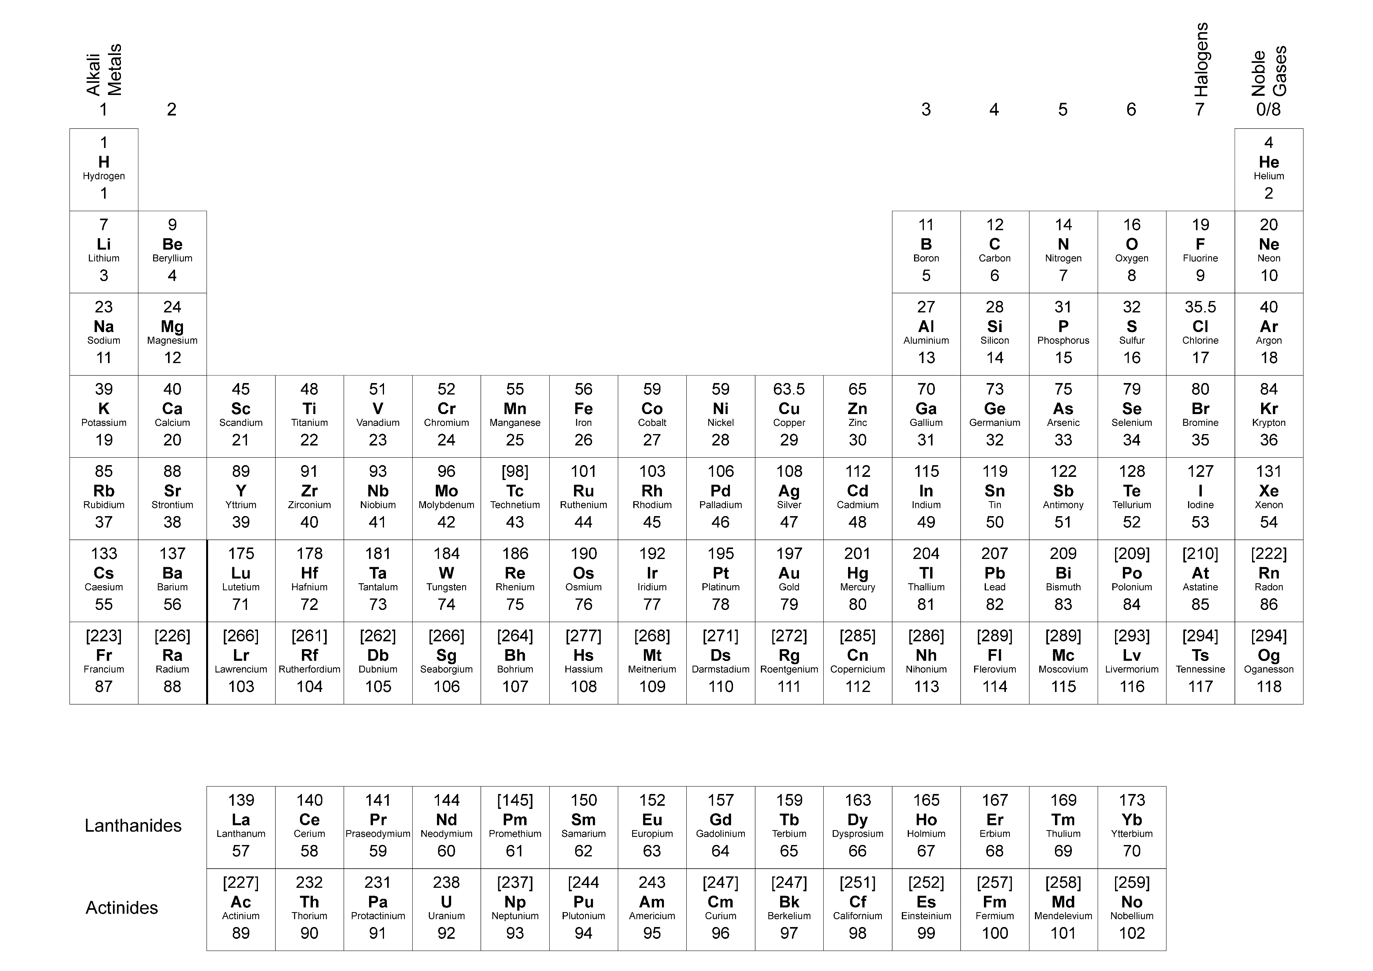
The Periodic Table

Slide 17
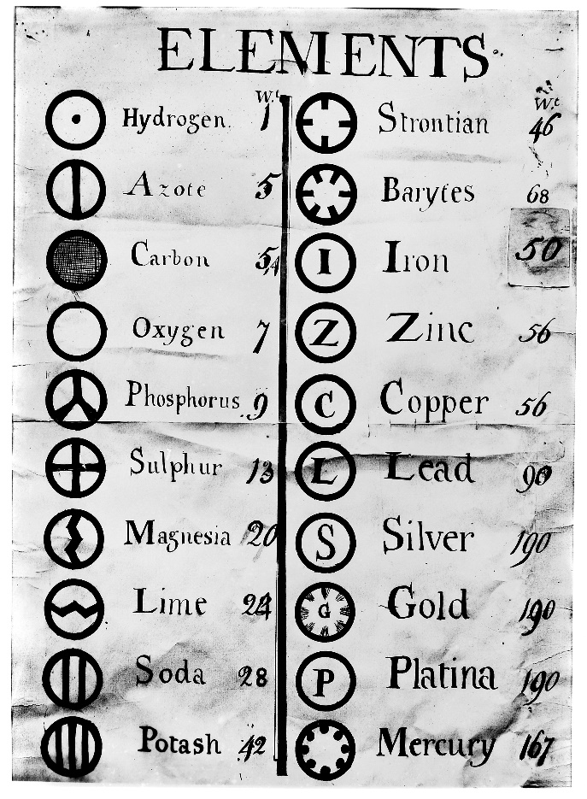
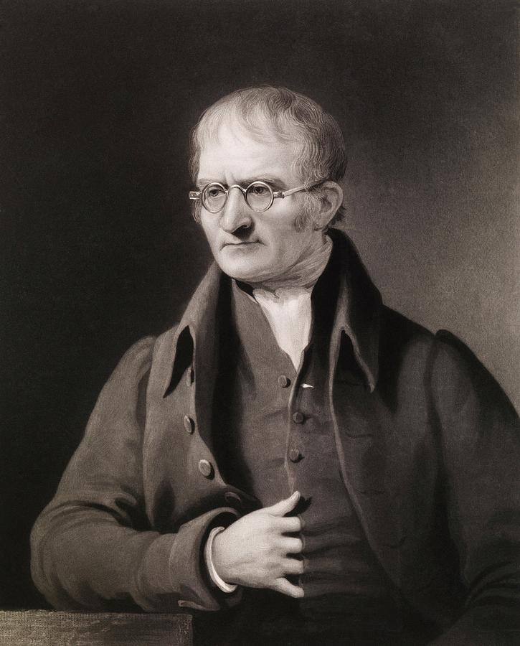
John Dalton

Slide 18
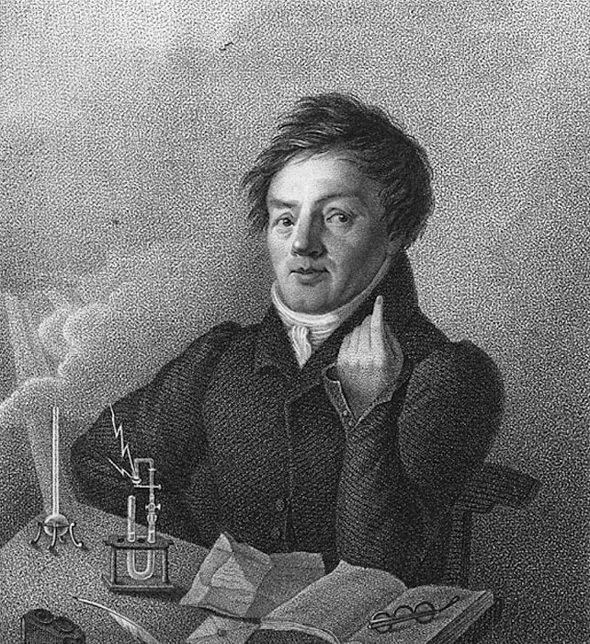
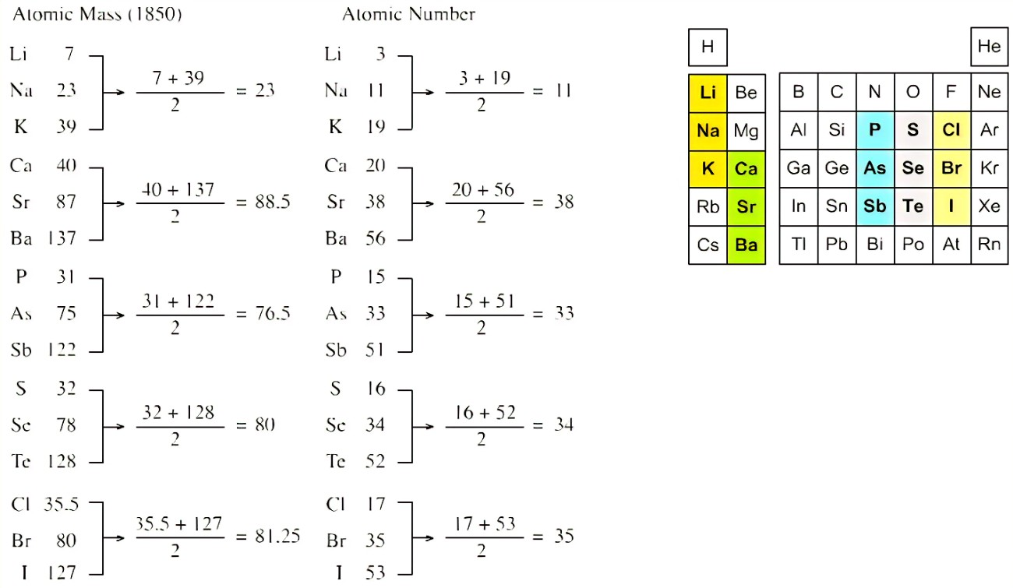
Johann Wolfgang Döbereiner

Slide 19
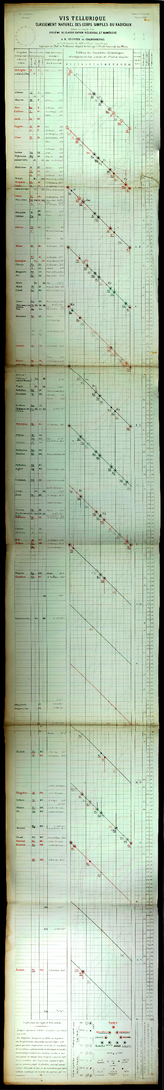
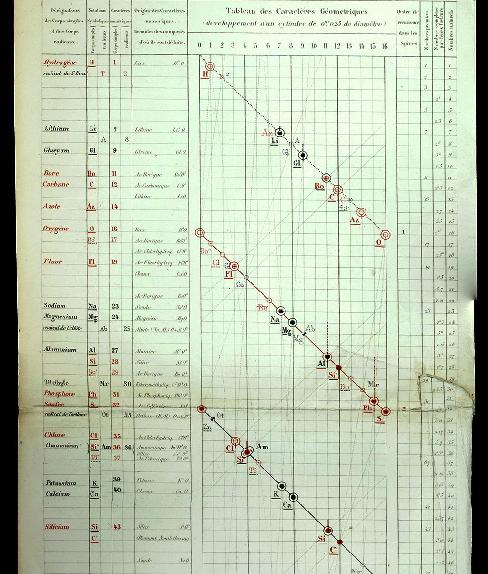
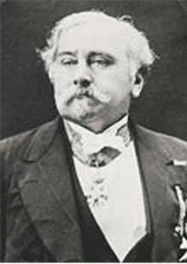
Alexandre Emile Béguyer de Chancourtois

Slide 20
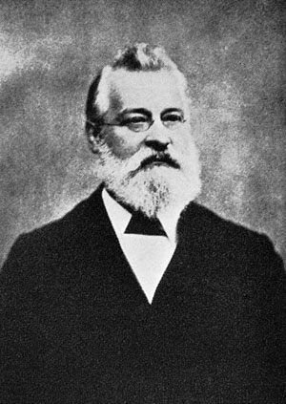
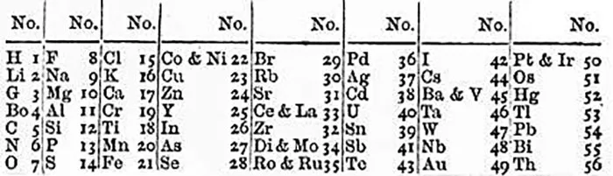
John Newlands

Slide 21
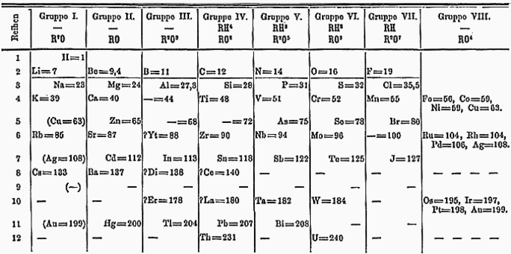
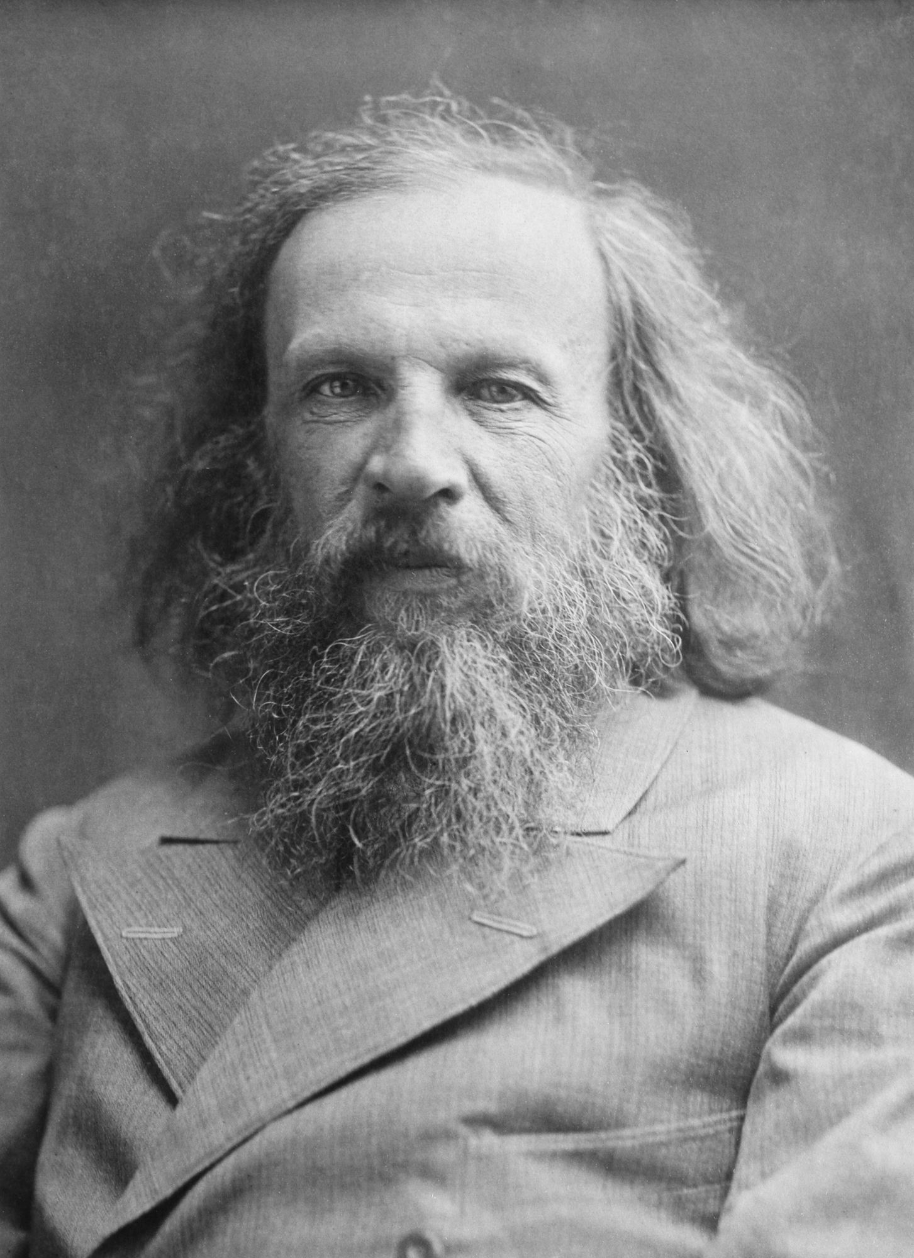
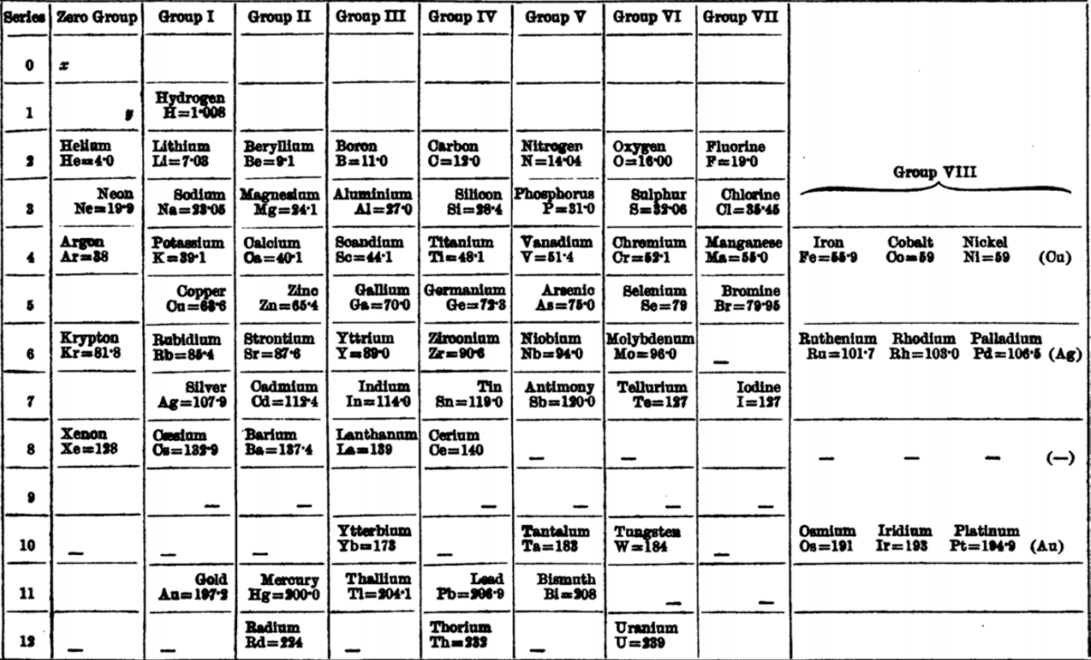
Dmitri Mendeleev

Slide 22
Progress Check Page 12
John Newlands | 1864
Dmitri Mendeleev | 1869
John Dalton | 1806

Slide 23
Reading the Periodic Table
Atomic Number Range | Period | Elements in Period
0-2 | 1 | 2
2-10 | 2 | 8
11-18 | 3 | 8
19-36 | 4 | 18
37-54 | 5 | 18
55-86 | 6 | 32
87-118 | 7 | 32

Slide 24
Mastery Questions Page 12
1. Dmitri Mendeleev (1)
2. Increasing atomic number (1)
3. Period 5 (1)
4. Each point worth 1 mark – maximum of 3:
Hydrogen is in a group with the halogens
allow whereas in the modern version H is on its own
Only seven groups as there is no Group 8/0 so no noble gases, therefore fewer elements
Halogens are in Group 1
allow but are located in Group 7 in the modern table
Other elements are in one group higher
allow for example oxygen is in Group 7 instead of Group 6
The modern table only has two elements in the top period
The modern table does not have the elements in order of atomic mass
allow but in order of increasing atomic number
Metals and non-metals not at opposite ends

Slide 25
The Reactivity Series

Slide 26
Deliberate Practice Page 13

Slide 27
Q1.
(a) argon / Ar
1
(b) (i) 0
1
(ii) unreactive
1
[3]
Q2.
(a) (i) 2,4 drawn (as dots / crosses / e–)
1
(ii) Water (vapour) / steam
allow hydrogen oxide / H₂O
do not accept hydroxide
1
[2]

Slide 28
Q3.
(a) Cu
1
2 CuO + C ➔ 2 Cu + CO₂
allow 2 CuO + C ➔ Cu₂ + CO₂ for 1 mark
1
(b) (i) iron is more reactive (than copper)
1
iron is cheap(er than copper)
allow cheaper or uses less energy than electrolysis
1
(ii) any two from:
• copper / ions move or are attracted to the negative electrode / cathode
• where they are reduced or gain (two) electrons
• where they form copper (metal / atoms)
2
[6]

Slide 29
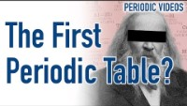
Timeline Page 17

Slide 30
Do Now Page 18
What electromagnetic ray is also a form of radiation?
What is the photosynthesis equation?
What is the name of the sixth chemical element?
Which force keeps objects on Earth?
How many bonds are there in a sulfuric acid molecule?
What is ATP (in one word)?
Gamma (γ)
Carbon dioxide + Water → Glucose + Oxygen (6CO₂ + 6H₂O → C₆H₁₂O₆ + 6O₂)
Carbon (12 - C)
Gravity
6 (H₂SO₄)
Energy (Adenosine triphosphate - C₁₀H₁₆N₅O₁₃P₃)

Slide 31
Lesson 3 DNA and Protein Synthesis
Biology
Taught By: Tyler Rocha
Scientific Advisors: Neo Skinner and Ephram Matocha

